Slide 1
1. Grossman and Krueger
Economic Growth and the Environment
QJE 1995

Slide 2
What will continued growth do for the environment?
Four types of indicators
  Urban air pollution
  State of oxygen in river basins
  Fecal contamination in river basins
  Contamination of river basins by heavy metals

Slide 3
Data
Global Environmental Monitoring System (GEMS) Panel data which asked for comparable data across countries
GEMS was joint project of WHO and UN Environmental Programme
Time coverage varies by pollutant and country and individual cities
E.g., SO2: 47 cities in 28 countries from 1977 in specific stations
GDP data from Summers and Heston (PWT)

Slide 4
Method
Use reduced form estimates of effect of GDP on pollution: Advantages:
  Less measurement biases than in structural model
  Do not have good data on the regulations , technology
Disadvantages: Can’t explain why the relationship holds

Slide 5
Estimation Model
Y_{it} =G_{it}β+G²_{it}β₂+G³_{it}β₃ +Gbar_{it}-β₄+Gbar²_{it}-β₅ +Gbar³_{it}-β₆ +X_{it} β₇ + ε_{it}
Where Yit is measure of pollution in station i in year t,
G is GDP per capita , Gbar is average GDPPC _{over 3 previous years}
Estimated with GLS allowing error term to have both a fixed component for station i and the random error

Slide 6
Results
Virtually never show that higher GDP per capita keeps increasing pollution
Usually this is only from low to slightly higher levels of income per capita . After that it declines
This became known as the environmental Kuznets curve (EKC)
But don’t know the explanation for this: regulation as income rises, change in composition of output?

Slide 7
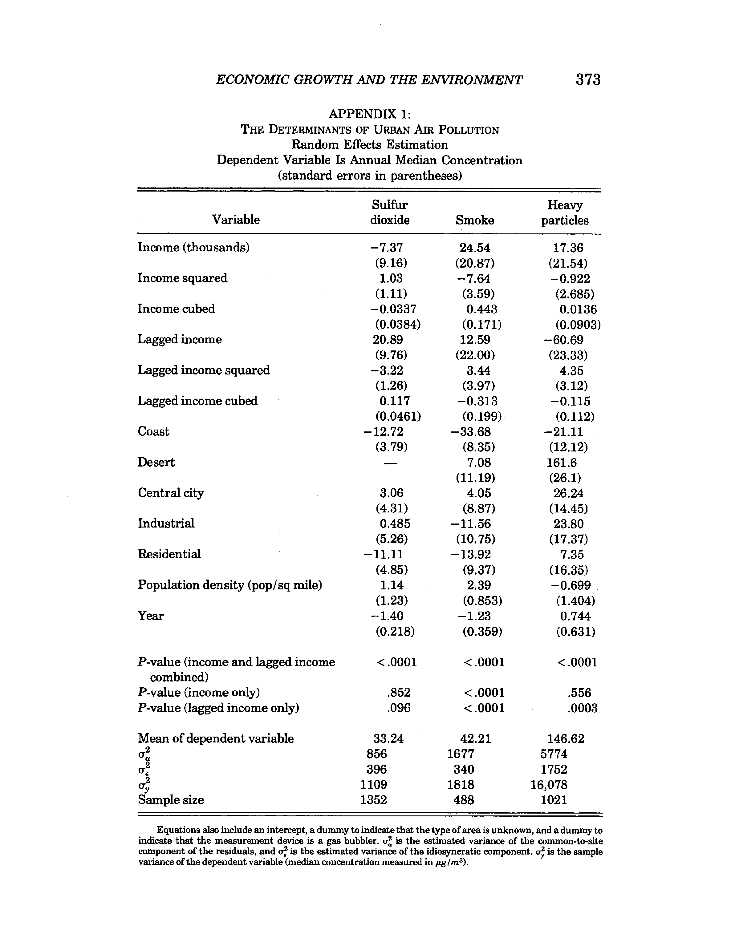

Slide 8
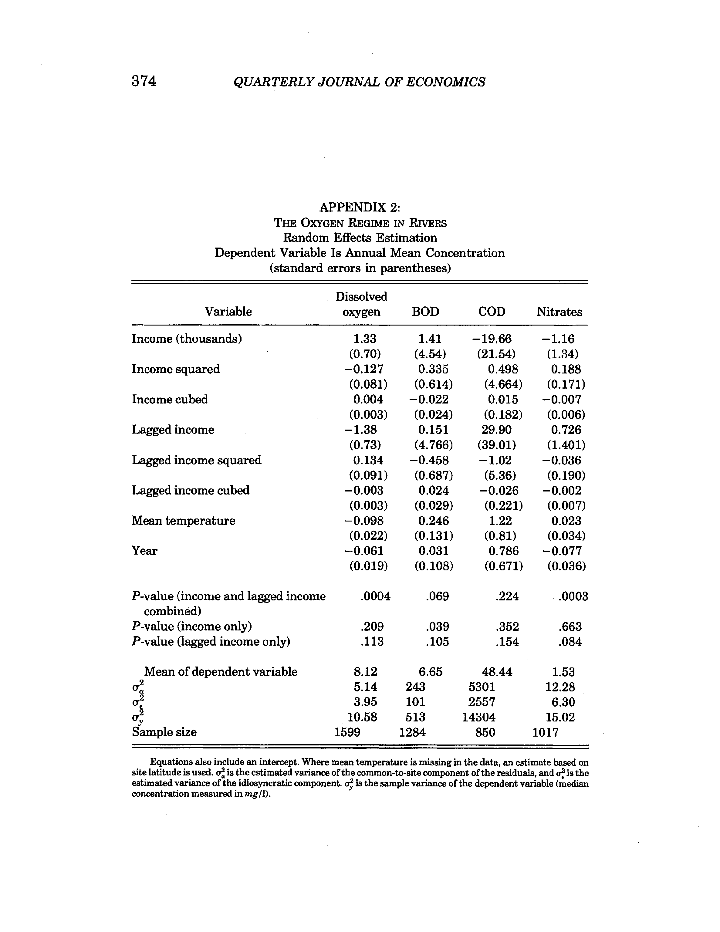

Slide 9
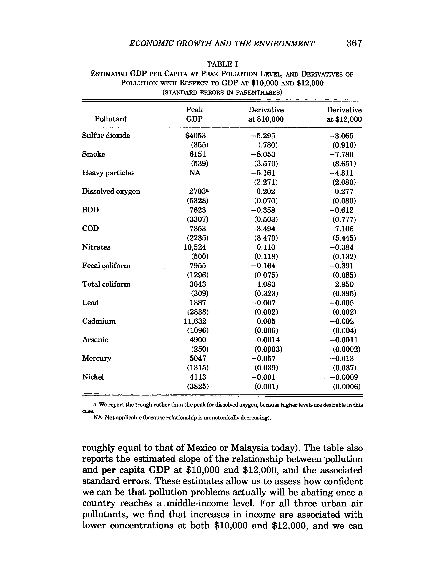

Slide 10
Conclusions
Environmental Kuznets Curve inverted –U
Turning point for most pollutants is below $8000 of GDP per capita
This has also been found for deforestation Shafiq and Bandopadhyay 1992
Exceptions are municipal waste and CO2

Slide 11
2.Is Trade Good for the Environment?
Werner Antweiler, Brian Copeland and M. Scott Taylor, AER
Their purpose is to identify mechanisms behind that relation with particular emphasis on trade, factor proportions
To this end they develop a theoretical model for small open economy

Slide 12
Model of Small Open Economy
Two sectors: y, labor intensive w/o pollution with p=1, x, capital and pollution intensive and p=p
Value of output at international prices
Scale S = px+y
Composition of output measure by x/y
Output in each sector = f(K, L)
But abatement technology can be used in X A(xa,B) where B is base pollution in absence of abatement. Pollution Z =x-A(Xa,X)

Slide 13
More Theory model
Producers in each sector have cost functions in terms of factor inputs . Free entry and competition so profits =0
Consumers max utility f(G/N in real terms, Z)
Government determines pollution policy, i.e., size of pollution tax
Pollution will thus rise with scale of the economy and capital abundance
Increases in income, marginal disutility of pollution and numbers of people affected by pollution lead to tightening of pollution control
Trade openness and pattern will also matter

Slide 14
Overall effects have to be broken down into 3 Different Effects
Composition Effect: trade will cause some industries to expand, others to contract. These differ in pollution intensity
Scale Effect: the effect of overall economic activity
Technique Effect. With higher incomes people demand cleaner techniques
Composition effect found to be small and of the others the technique effect outweighing the scale effect
Hence the source of growth matters for pollution.

Slide 15
Data
GEMS for pollutants 293 observation sites in 109 countries 1971-96
Use log of median SO2

Slide 16
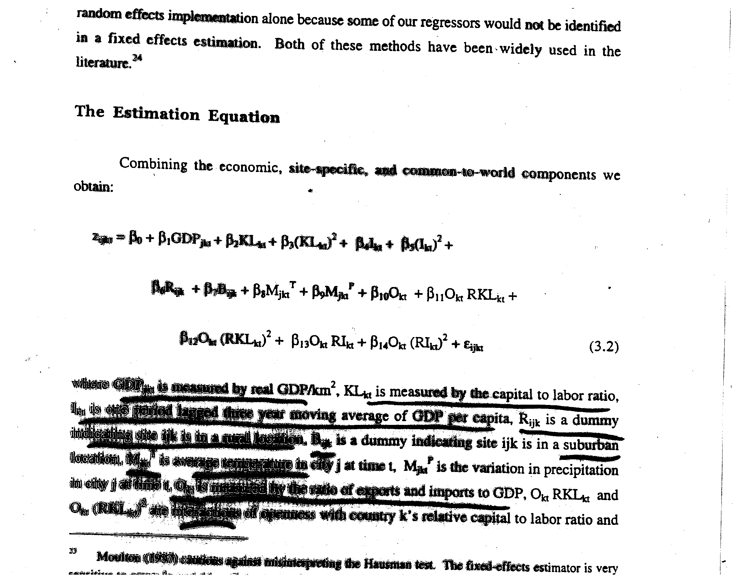

Slide 17
Data Source: Global Environment Monitoring Project
Focus on Sulfur Dioxide (SO2)
Panel estimates in Table 1
Includes climatic and other environmental conditions

Slide 18
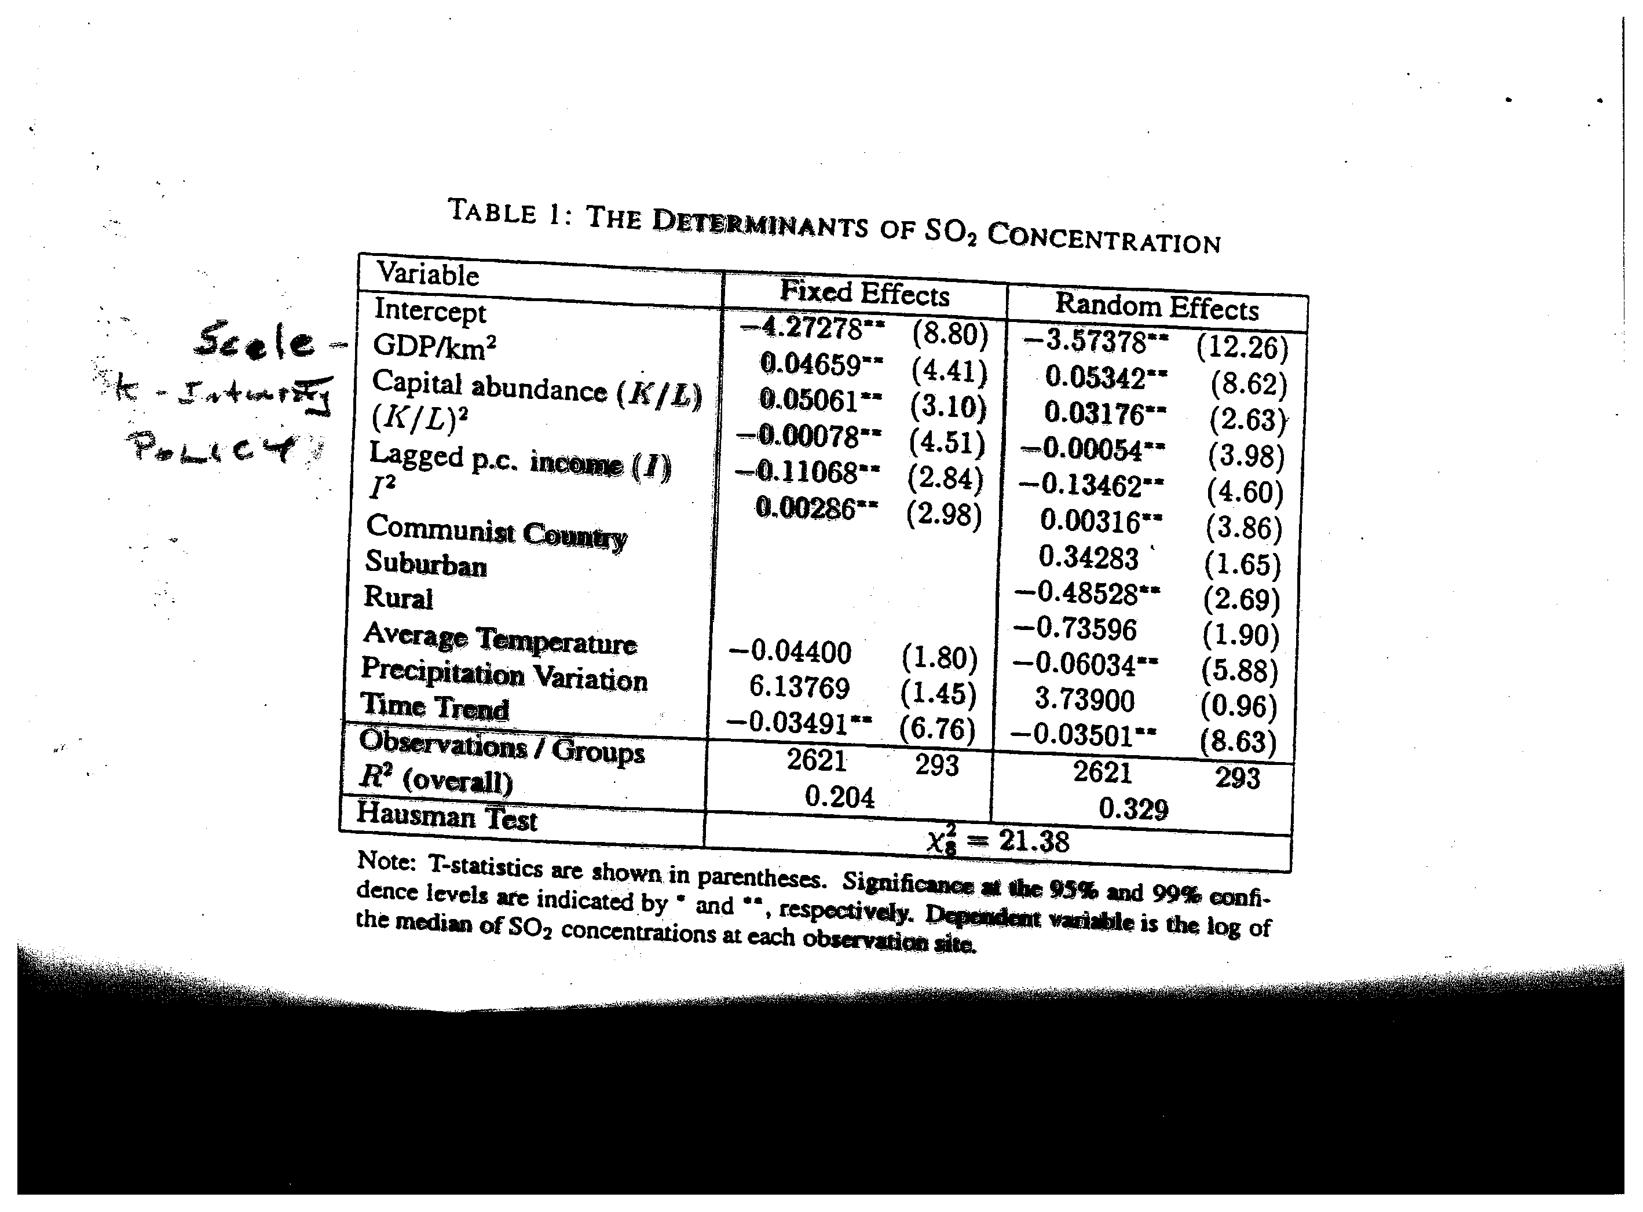

Slide 19
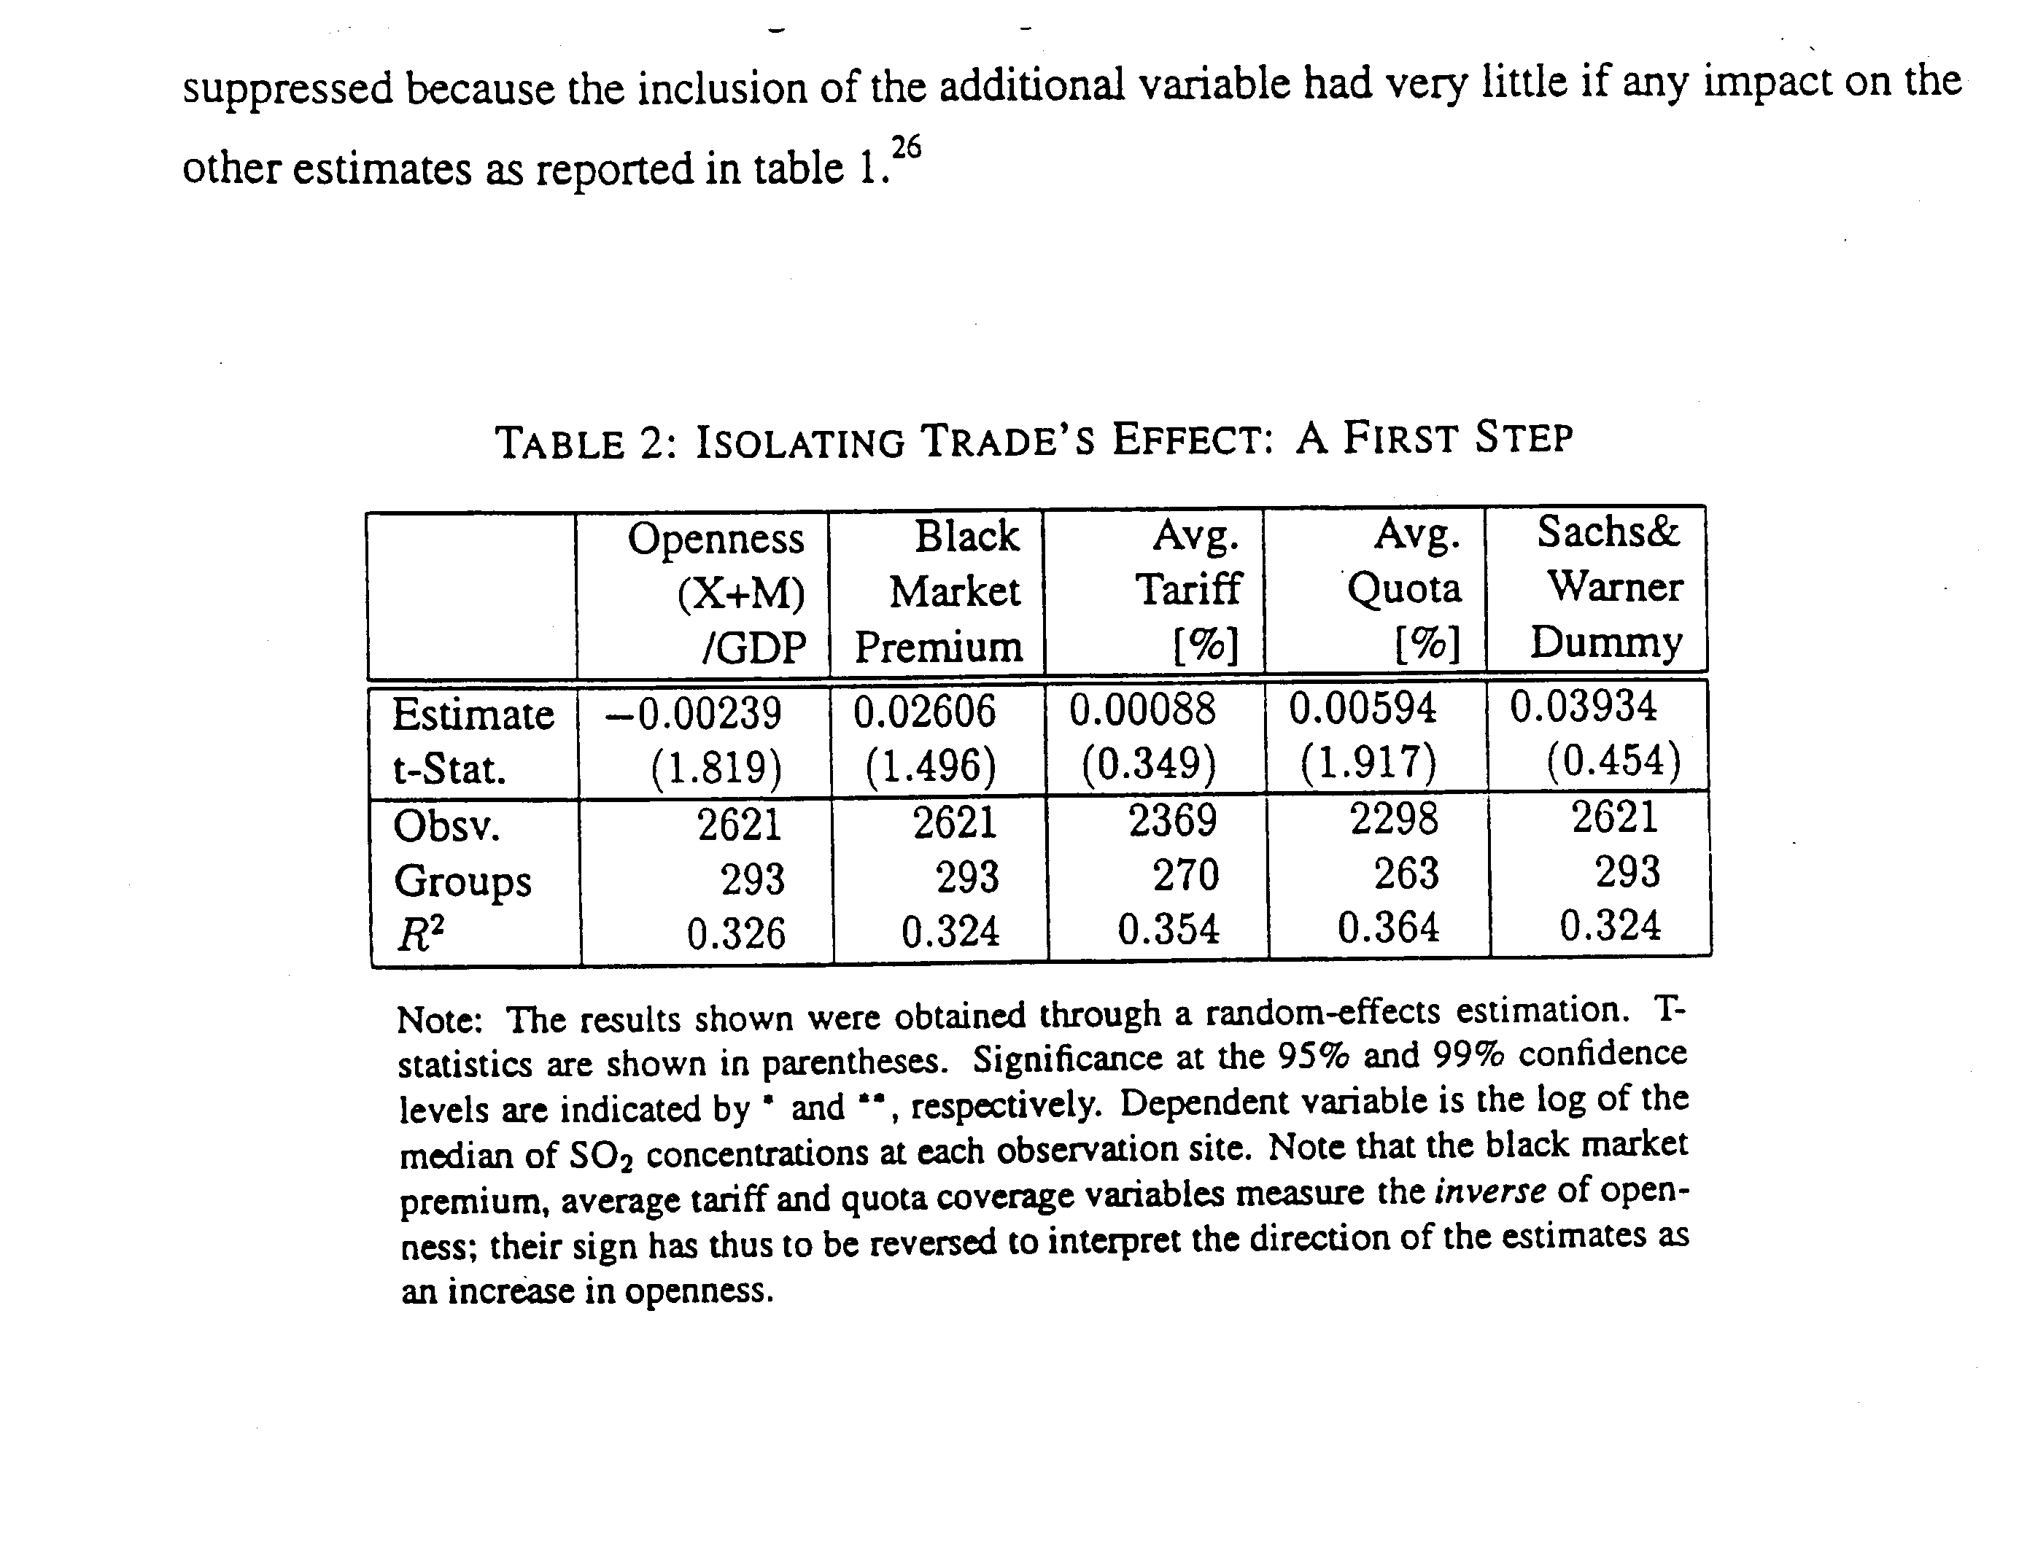
Note that these results do not show significant effects but this is after
controlling for many other differences across countries, which would differ from one country to another

Slide 20
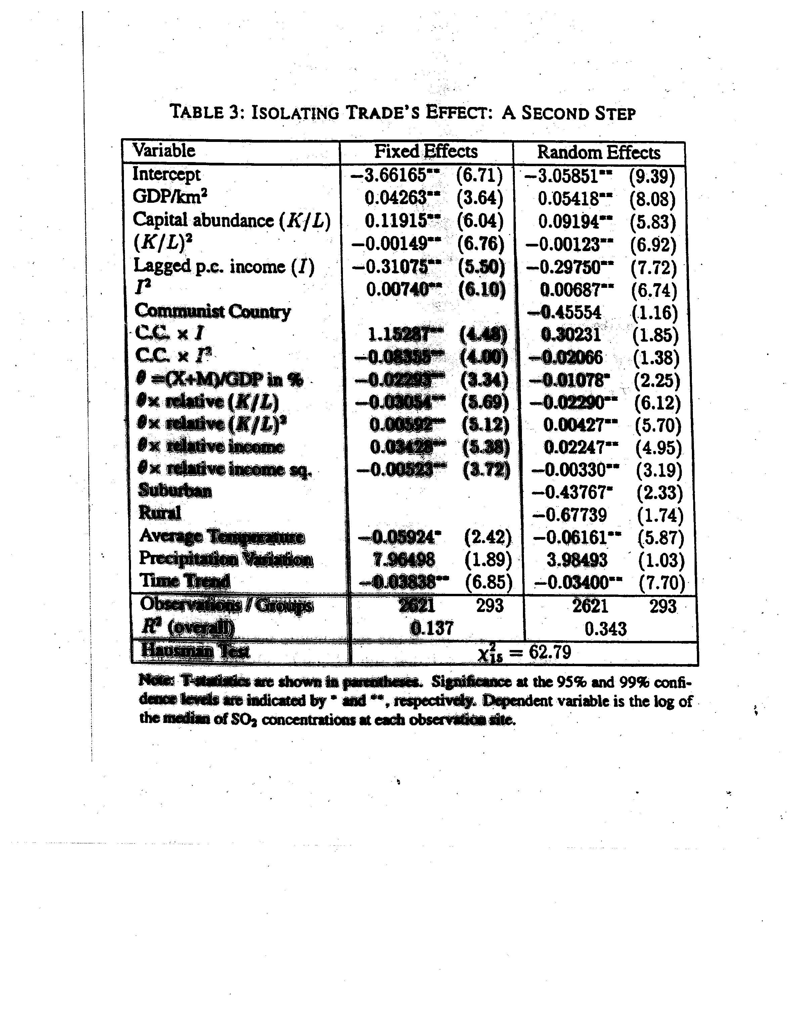
Next try to condition on country characteristics

Slide 21
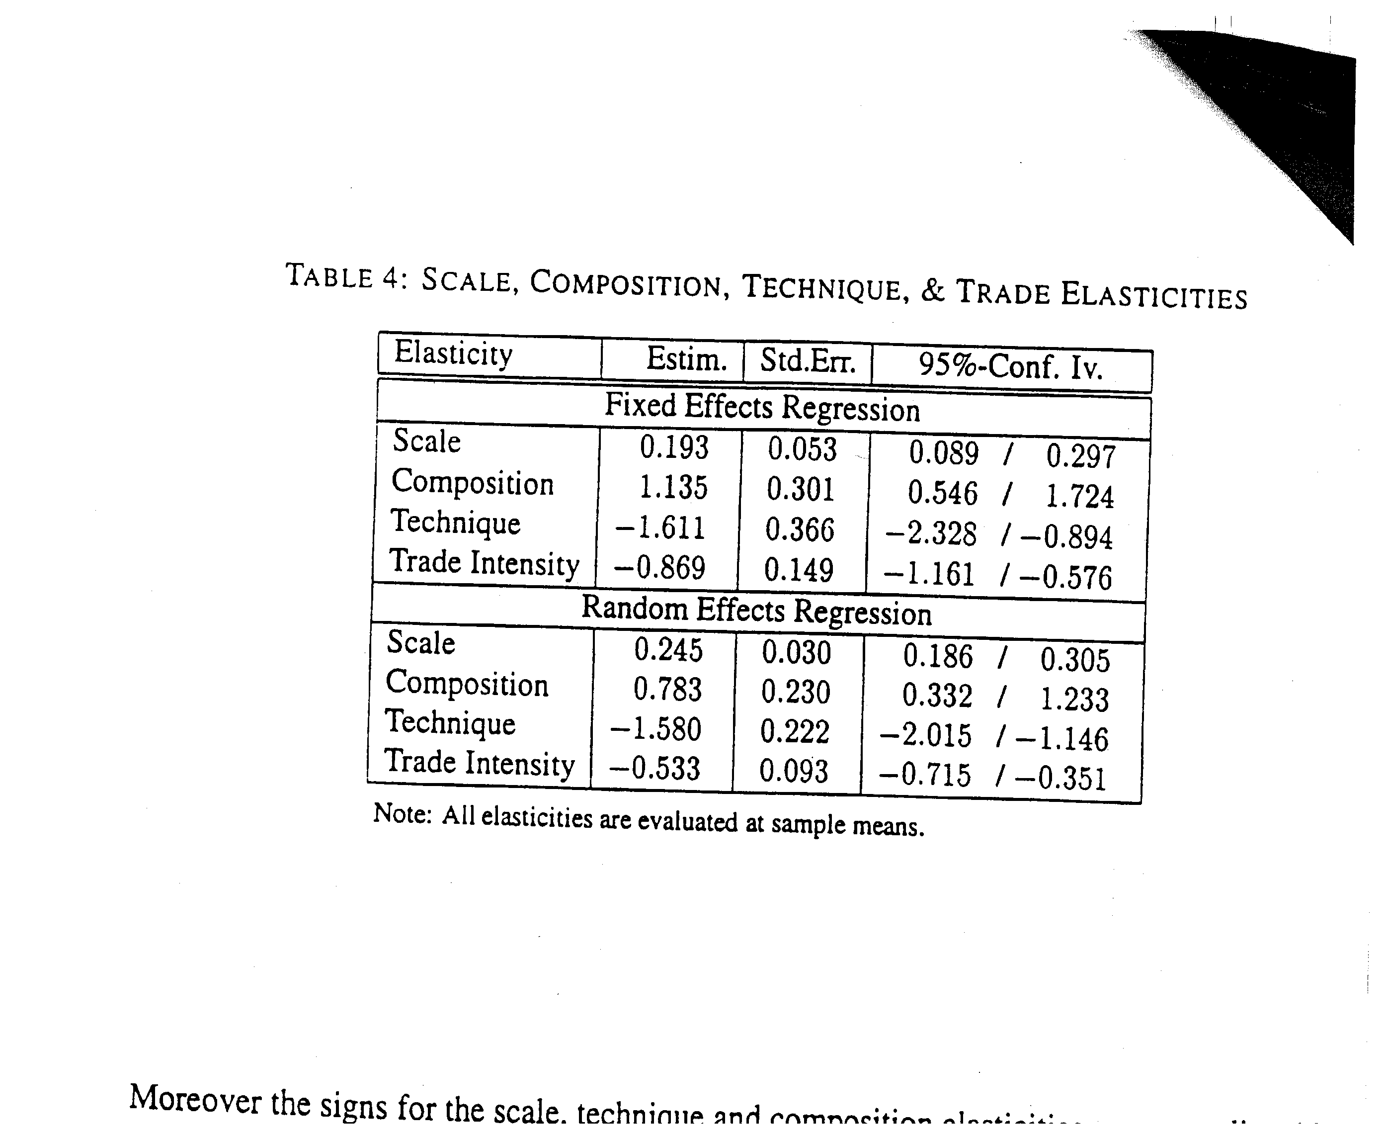
Now Estimating all four major determinants

Slide 22
Conclusions
While openness to trade both increases income and output by 1%, the net effect is to reduce pollution by 1%
Overall therefore trade is good for the environment

Slide 23
Comments
Sample is heavily weighted toward US as a result of the many environmental monitoring stations in US.
Virtual absence of data from LDCs (only China)
Investigate only SO2 whereas Nakao and Grossman and Krueger had studied other pollutants and showed that turning points with income different by pollutant
May exaggerate the technology and scale effects since not all growth comes from trade

Slide 24
More Comments
Environmental policy, such as pollution or carbon tax may exist for reasons other than pollution control, such as income redistribution, revenue generation, or trade policy if the latter is constrained

Slide 25
3. The Green Solow Model
Brock and Taylor
Journal of Economic Growth

Slide 26
Existing Theories of EKC
Generally narrowly focused on relationship between pollution and per capita GDP
  1. Threshold effects in abatement that delay the onset of policy
  2. Income driven policy changes that get stronger with income growth
  3. Structural shift to services
  4. Increasing returns to abatement that lower costs of pollution control

Slide 27
Bring in Additional features of data to show that these explanations don’t fit facts
Timing of pollution reductions shows reductions in pollution intensity well before the reductions in aggregate pollution
Time series of abatement costs per unit of output do not show much increase despite sharp reduction in pollution
Changing composition of output has played little role (Selden et al 1999)
Increasing returns in abatement seems unlikely given the multiple different small sources (cars, houses, and lack of massive merger activity

Slide 28
How to deal with 3 puzzles?
Large reductions in emission intensities with static pollution abatement costs
The EKC shape
Why are empirical estimates of EKC sensitive to sample and estimation procedure?
Green Solow Model can do this with alternative empirical methodology. This yields convergence in emissions per capita across countries, consistent with List et al

Slide 29
Three Observations based on US Data
Falling emissions per unit of output prior to reductions in emissions (Fig 1)
Emission levels display inverted U
Notice that reductions in emission intensities in Fig 1 precede the peak in Fig 2
Fig 3 total expenditures on pollution abatement costs per dollar of GDP. These rise rapidly until 1975 and then remain quite constant.
To show that these are not US-specific , Table 1 shows many of these to be similar.

Slide 30
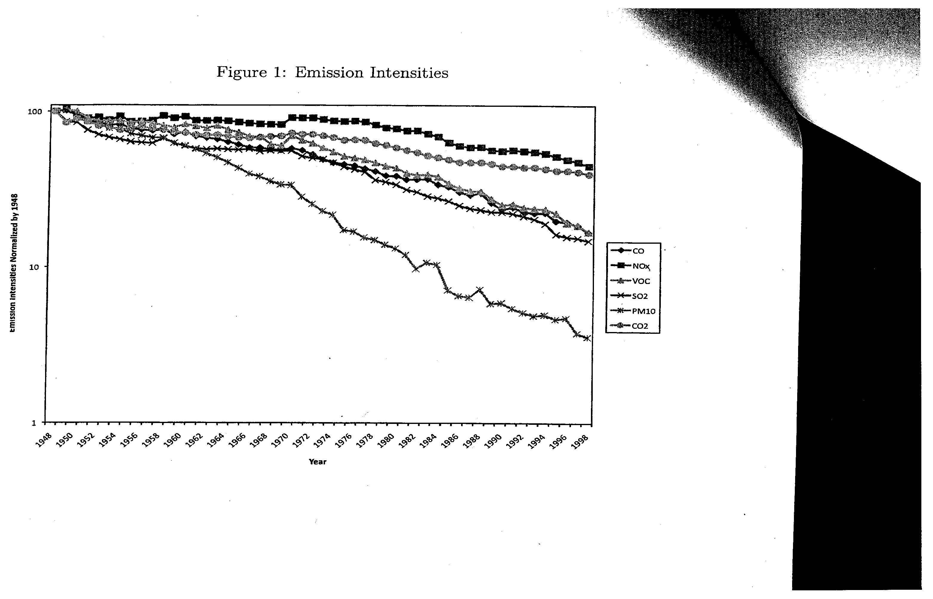

Slide 31
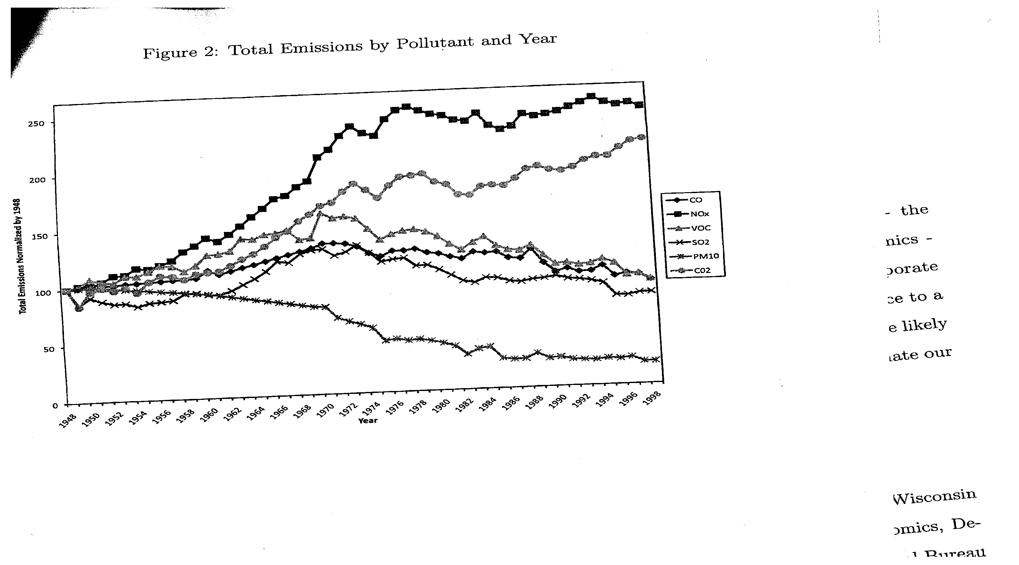

Slide 32
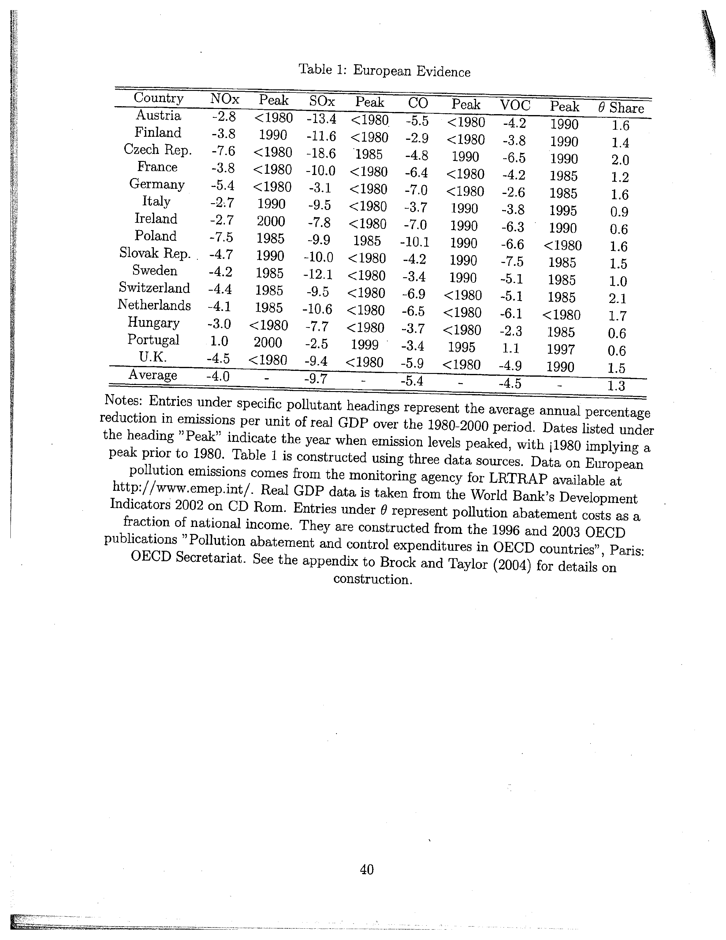
This table show s that US pattern also applies to European countries

Slide 33
The Model
Both Savings rate and abatement leads to steady growth with rising environmental quality
Y = F(K,BL) where B= labor augmenting Technical progress and g_{B} is its growth rate
Kdot =sY-δK
Ldot=nL , Bdot =g_{B}B
E=ΩF-ΩA(F,F^{A} a ( θ) ) where Ω is the pollution per unit of output F, F^{A} is effort at abatement
E= ΩF[1-A(1,F^{A}/F)]
E = ΩFa (θ) where θ =F^{A}/F
a(θ) =[1-A(1, F^{A}/F)]

Slide 34
Transforming into intensive units
y=f(k)[1- θ]
kdot =sf(k)[1- θ) – [δ+n+gB]k
E=f(k) Ω a(θ)
Balanced growth path g_{y}=g_{k}=g_{c}=g_{B}
Growth rate of emissions along balanced growth path g_{E}=g_{B} +n-g_{A}
Sustainable growth defined as balanced growth path with rising c percapita and improving environment g_{B>0 and} g_{A}> g_{B} +n

Slide 35
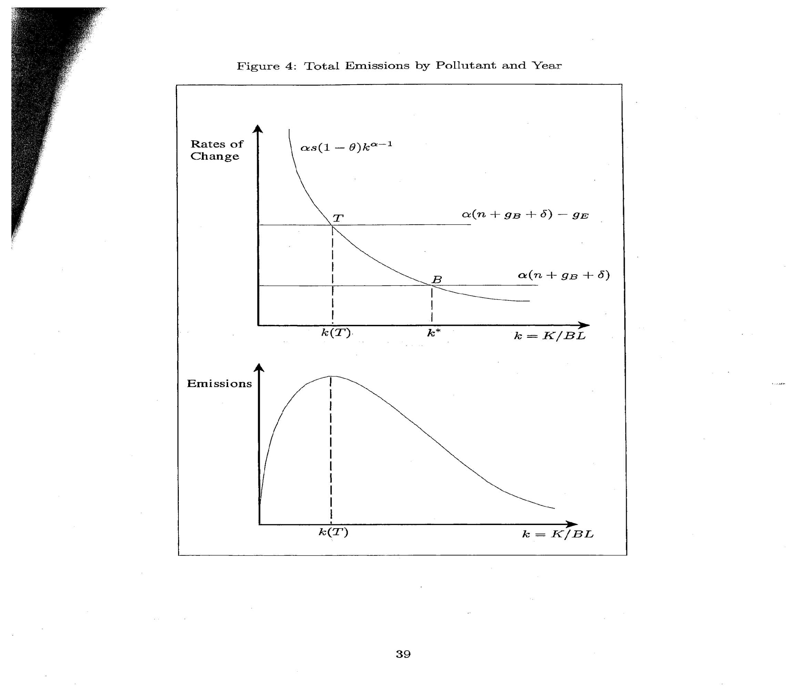

Slide 36
Figure 4
Top part is akin to standard Solow model of steady state . It assumes that g_{E} <0
Bottom part follows from top part and plots emissions as f(k)
E=B(0)L(0)Ω(0)a(θ)exp (g_{E}t)k^{α}
^{Initial conditions}
Differentiating wrt time to get growth of emissions
Edot/E ⁼ g_{E} + α kdot/k
Where kdot/k =sk ^{α-1} (1- θ)-(δ+n+g_{B})
Capital per effective worker rises at all points to left of B (at k*) but the rate of growth declines. On balanced growth path Y and K grow at rate g_{B}+n
Gap between the savings locus curve and the horizontal line is % rate of change in emissions Edot/E

Slide 37
Model shows
EKC can occur even without any policy change which makes it more likely for a variety of countries including non-democratic ones. Policy change would be reflected in increase in θ. This would lower emissions but not a long run one on steady state, just as savings rate does not affect long run growth rate. It cannot make growth sustainable if it wasn’t before. Peak emissions are reached at lower levels of Ypc than otherwise

Slide 38
In short run, however, Policy
Creates drag on transitional growth as it lowers (1-θ), shifting savings locus to left thereby lowering T and B. Time to peak emission falls (in part because abatement it takes away resources from investment)

Slide 39
Effect of rise in tech progress
Rise in gA, shifts the higher line in Fig 4 upward, lowering k(T). This lowers the growth rate of emissions for any k and also in the steady state. But no effect on growth of output or k*. T is reduced.
Rise in gB shifts top line in Fig 4 downward, raising T and the bottom line upward, lowering B. Time to peak emissions could rise or fall.

Slide 40
Effect of Population Growth
Lowers steady state k* and transitional growth at any give k
Raises emissions via scale effect and this raises emissions growth and the point at which emissions start to fall

Slide 41
Complexity of relationships in model
Initial conditions B0 and Ω0 affect transition paths for emissions and income but not on steady state magnitudes or long run growth
s and θ affect both transition paths of emissions and income and steady state magnitudes but not long-term growth rates
g_{A}, g_{B},and n affect all these

Slide 42
Predictions of Model
1. For countries sharing common parameter values but differing initial conditions , will display absolute convergence in emissions per capita
2. For countries with different parameter values, conditional convergence in emissions per capita requires certain conditions on country characteristics

Slide 43
Empirical specifications
With various simplifying assumptions obtain Short: [1/N]log [e^{c}_{it}/e^{c}_{it-N}] =β₀+β₁ [e^{c}_{it-N}] +μ_{it}
Long:[1/N]log [e^{c}_{it}/e^{c}_{it-N}] =β₀+β₁ [e^{c}_{it-N}] + β₂(s_{i})
+β₃log (1-θ_{i}) +β₄log[(n+gB+δ)_{i}]+ μ_{it}
When countries differ in determinants of their steady states, short version pushes these into μ_{it}
If these are correlated with emissions per capita, this would result in biased and inconsistent estimates, so long specification preferred. The long version also unbundles the determinants of the steady state

Slide 44
Data
Carbon dioxide emissions mostly from energy use so energy reduction per unit of GDP is relevant
Collected from 173 countries 1960-1998 (ending prior to Kyoto agreement ) Sample A
Sample B: Smaller set (165 countries) for which Conditional convergence can be evaluate because of data on n and I/GDP
Sample C excludes OPEC countries
Sample D excludes counties with pop < 1 mill.
Sample E excludes countries not rated in PWT

Slide 45
Choice of CO2 favored by
Prior to 1990s there was no abatement of carbon so cost share of investment in this was near 0. Hence any convergence would not be due to convergence in environmental policy
While this CO2 pollution data is available from GEMS from 1970s there is no consistent data n emissions for as long a period and set of countries to capture effects of s, n
Convergence wrt carbon has not been demonstrated though it is sometimes assumed and is property of this Green Solow Model
Carbon emissions not trending downward for many countries. Can distinguish between EKC and less restrictive one of convergence

Slide 46
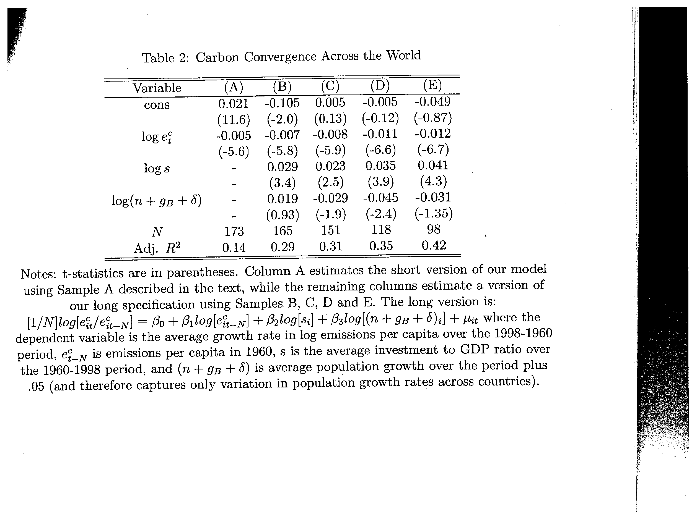

Slide 47
Results
Point estimates are reasonable
  Convergence 0.5<λ<1.6%
  Β₂ ₌ -β₃ cannot be rejected
  Estimate of capital share =0.7 is too high as Barro (1991) had found in estimating standard Solow model
  Positive effect of savings
  Sample E countries had growth of emissions per capita of 1.98% per year, I share of 21.3% and n of 1.54% per year
  Rise of s from 21.3% to 31.3% would raise emissions growth by 1.57% per year (compared to average base of 2% over last 30 years) but would not affect long run growth rates
  If n doubled from 1.54 to 3, no effect on emissions per capita growth but would raise emissions growth by 1.54% . Outside of steady-state, it lowers k, labor productivity. Growth and emissions per capita

Slide 48
Robustness
Findings similar in case of panel , examining sigma convergence
But it remains to be demonstrated that Green Solow forces were critical in the declines in criteria pollutants in Figures 1,2 and Table 1
Puzzle: Source of decline in emission intensities prior to 1970s which was before EPA and stringent regs of 1970s . There were state regs before this however. Can be just plain cost minimization. Do not deny that EPA regs have played a role, but how big?

Slide 49
Conclusion
Suggests that EKC and Solow model intimately related, technological progress linked to both phenomena. This supported by evidence
Extend Solow model to reflect diminishing returns in k and tech progress in abatement yields profile of emissions, abatement costs, emissions intensities that fit US, Euro data
Developed an empirical methodology flowing from the model. Results support predictions of model

Slide 50


